Slide 1
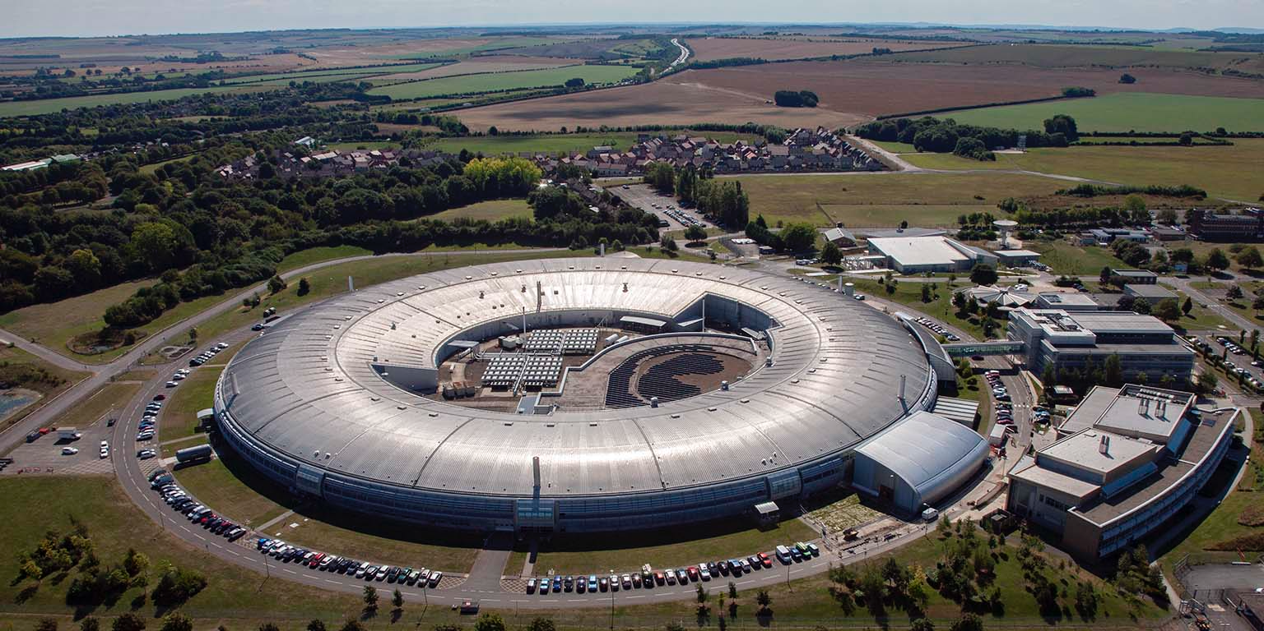

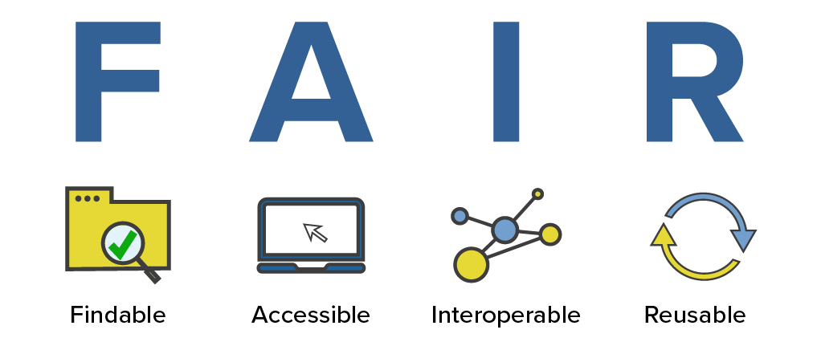
Shaping a modern approach to open data from a World-leading science facility
Terence Tan, DPhil student
Diamond-Oxford Research Project (4 years) – Information Engineer
Data Readiness Group, Department of Engineering Science
University of Oxford
Supervisors: Steve Collins (Diamond), Susanna-Assunta Sansone and Philippe Rocca-Serra (Oxford)
Project Stakeholder Group: Brian Matthews (STFC), Kirsty Syder (Diamond), David Aragao (Diamond), Tim Snow (Diamond), Renaud Duyme (ESRF, PaNOSC)

Slide 2
Research Overview
How does the adoption of FAIR Principles at Diamond affect synchrotron data management?
What benefits do the FAIR Principles bring to Diamond as an organisation and to its science life cycle?
Identifying a key stage in the Diamond's "science life cycle"
use it to jumpstart the FAIRification process in other stages
Evaluating the impact of proposed improvements
assess challenges and opportunities to scale the process
Leveraging on and complementing the activities of existing communities and efforts
contribute novel insight and possible solutions
serve as example for other synchrotron facilities
Project Stakeholder Group: representing key interests and perspectives

Slide 3
Outline
High level introduction
The FAIR Principles
FAIR in Diamond
Relevant communities, projects and activities
My project
Work done
Workplan
Possible benefits
Risks and mitigation
Discussion and feedback

Slide 4

Globally unique and persistent identifiers
To search and retrieve data
Standardised metadata
To make data more discoverable and interpretable
Standardised terminologies
To assign the same meaning to the same term
Terms of access being maximally open but as restricted as required
To understand how to access data
Disambiguate use conditions
To promote innovation and reuse
Comprehensive provenance and workflows
To contextualise data and enable its use in practical settings

Slide 5
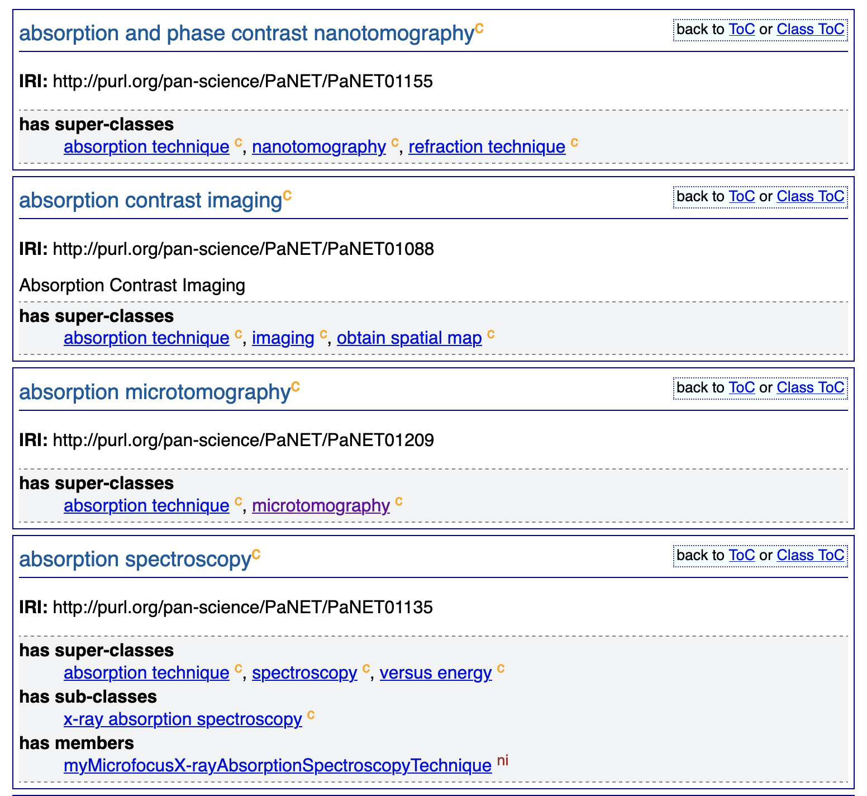
Value of machine actionable (meta)data
E.g. PaNET ontology: http://purl.org/pan-science/PaNET/PaNET01206
FAIR data means data that is machine-readable and actionable, two components essential to human-machine collaboration and autonomous machine-to-machine communication
FAIR data support verifiable and reusable science at scale

Slide 6
Diamond’s Goals
Goals
How does FAIR help?
1. To be a world leading facility in research
Deliver higher quality data service to users​
2. To maximise the impact of Diamond
Enhance the reputation of Diamond
3. To ensure the sustainability of Diamond
Maximise investment returns for funders​
4. To engage the public
5. To plan for Diamond’s future
Promote transparency and public trust in science​
Help Diamond guide strategic decisions regarding future capabilities, specializations, or expansions​
Improve the data management system for data managers​
Increase visibility for users​​

Slide 7

European science clusters
Astronomy & Particle Physics
ENVRI-FAIR
Life Science
EOSC-Life
Photon & Neutron Science
Environmental Science
Social Sciences & Humanities
PaNOSC
ESCAPE
SSHOC
ExPaNDS
Global initiatives
European initiatives
League of European Accelerator-based Photon Sources
The European strategy for accelerator-based photon science
NeXus International Advisory Committee
NeXus data format
Research Data Alliance
Photon and Neutron Science Interest Group (PaNSIG)
Tools and services, including the PaN Experimental Techniques (PaNET) ontology

Slide 8

My project: year 1 overview, and Transfer
Literature review of the FAIR landscape
focus on work done by the PaNOSC, ExPaNDS, PaNSIG communities
Set up and engage the Project Stakeholder Group
to get feedback on value, relevance and novelty of the proposed work
Flesh out the details of my workplan for the next 3 years
FAIRification of a specific stage of the "science life cycle"
risk assessment
benefits
The above is what I require to prepare the report for my Transfer exam

Slide 9
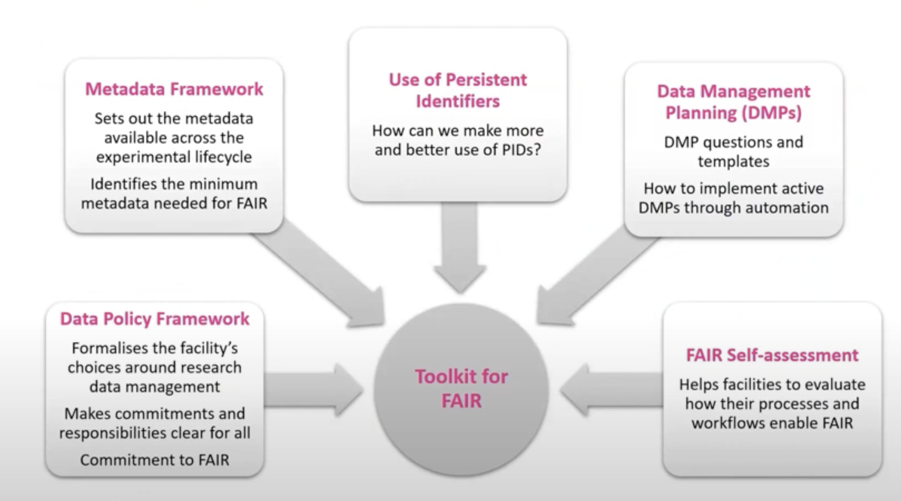
Familiarise with the PaN community work​
Started to read the reports and outputs of PaNOSC, ExPaNDS, PaNSIG
The FAIR toolkit/framework and its maintenance
Learning about the challenges and areas still requiring work, including culture change, implementation challenges, policy definitions, communication and dissemination
An example report: Boscaro-Clarke, Isabelle et al. (Jan. 2023). “ExPaNDS: Laying the Foundations for Achieving Open Science for Everyone”. In: Synchrotron Radiation News 36.1, pp. 25–28. issn: 1931-7344. doi: 10.1080/08940886.2023.2186664. url: http://dx.doi.org/10.1080/08940886.2023. 2186664.

Slide 10
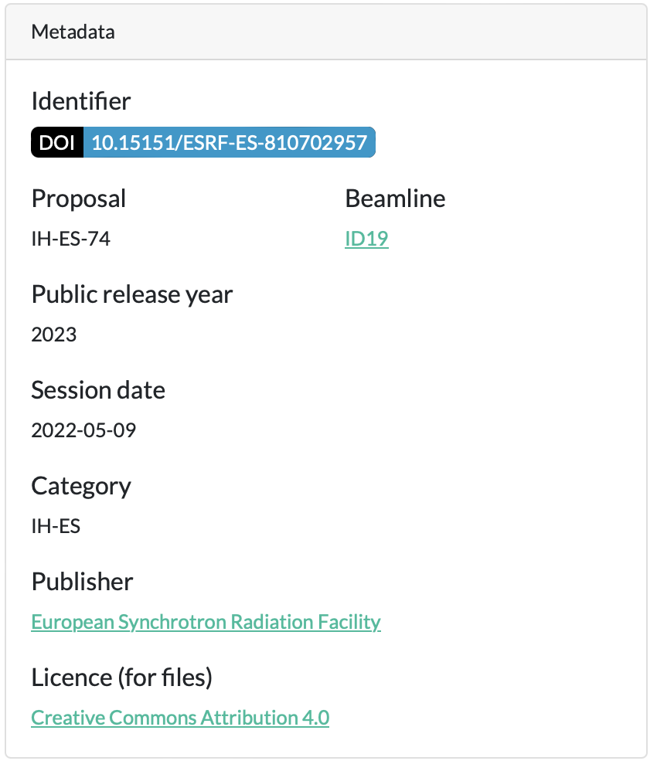
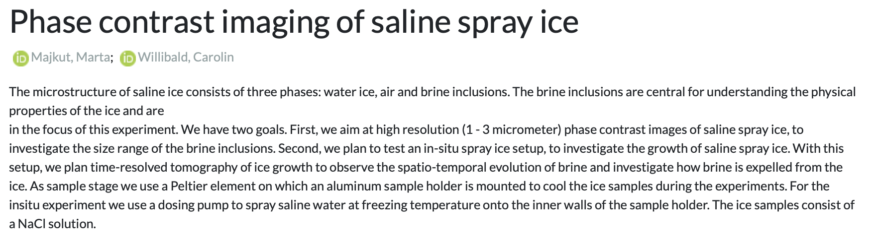
Identify a specific stage to focus on​
Proposal
Proposal review
Experiment
Data storage
Data analysis
Experimental report
Record publications
Diamond’s science life cycle

Slide 11
Diamond
Machine Learning community
FAIR ecosystem
Machine Learning techniques
Ontologies/taxonomies/vocabularies
Proposals
Metadata requirements
Machine-actionable metadata

Slide 12
Some of the metadata currently present in the proposals​
Experimental techniques
Eg. Phase Contrast Imaging
Chemicals
Eg. Sodium Chloride
Topics
Eg. Carbon Dioxide Sequestration in Geological Formations

Slide 13
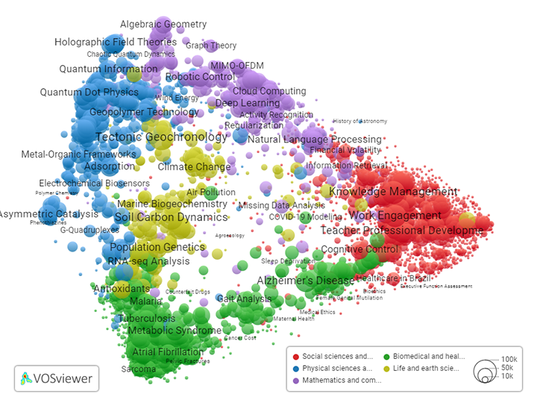
Extract and make metadata machine-actionable ​
Extract the metadata
ChemDataExtractor
CWTS Classification
Clustered publications based on citation links
Used GPT 3.5 to label each cluster with a research area
Link to ontologies/databases
PaNET
ChEBI
OpenAlex topic classifications

Slide 14
Ideal output of the FAIRification process
Topic
Ice formation
Substances
Water -> CHEBI:15377
Air
brine inclusions
Sodium chloride -> CHEBI:26710
Techniques
phase contrast imaging -> http://purl.org/pan-science/PaNET/PaNET01116
Tomography -> http://purl.org/pan-science/PaNET/PaNET01129
Proposal references
Proposal abstract

Slide 15
Summary of the workplan
Conduct landscape review of Diamond’s processes and science life cycle
Create a data pipeline
Analyse structure of proposal abstracts to determine what information is included
Literature review of existing ML/NLP techniques
Identify standards/ontologies for the scientific domains relevant in synchrotron science
Design the architecture of a data pipeline
Decide on a performance metric for the data pipeline
Investigate potential applications and pilots
Define methodology to evaluate how useful the potential application would be
Derive recommendations to Diamond for future work and directions ​

Slide 16
Potential application: proposal review process
External experts invited onto review panel
Proposals are manually assigned to reviewers based on matched expertise
Scientific review is conducted to judge the quality and potential impact of the experiment
Proposals are ranked, beamtime allocated down the list
Proposals are automatically assigned to the most appropriate reviewer based on a similarity ranking system

Slide 17
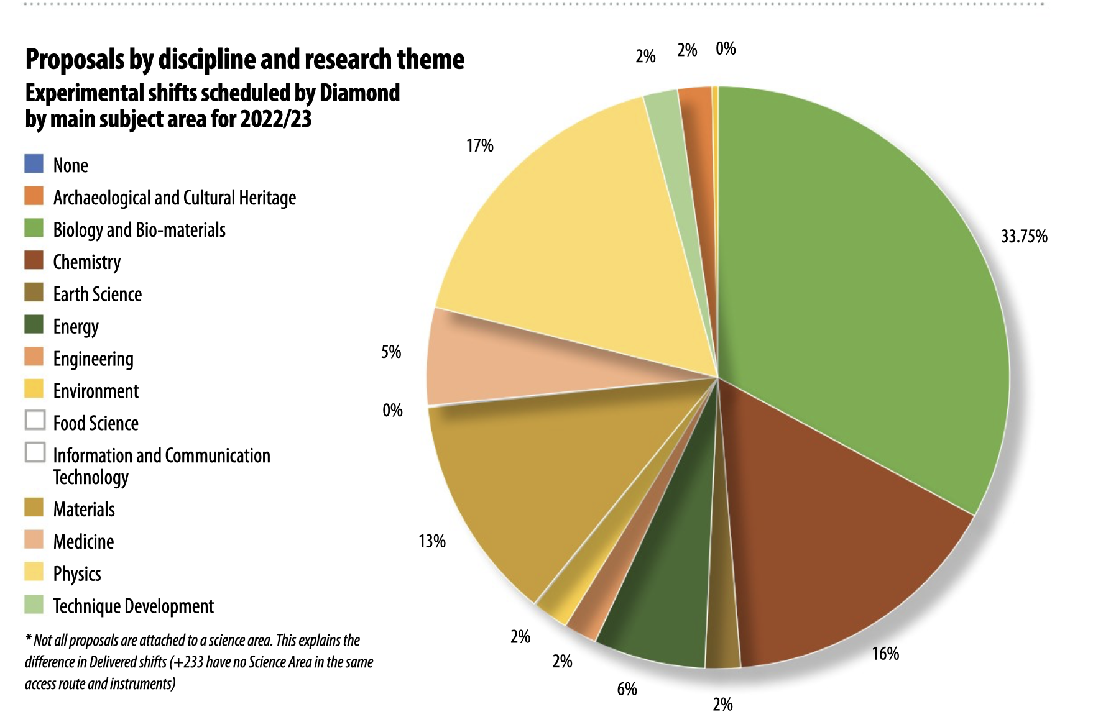
Potential application: classification of topics

Slide 18
Explore possible benefits
Proposal
Proposal review
Experiment
Data storage
Data analysis
Experimental report
Record publications
Optimise data storage organization?
Increase speed?
Enable quicker scheduling?
Automate aspects of data analysis?
Streamline report generation?
Classify by subtopic?
Evaluate quality of proposal?
Avoid duplication?
Ensure data is stored in a FAIR-compliant manner?
Enable the development of tailored analysis tools?

Slide 19
Risks and mitigation
Project-specific
How long would it take to label datasets for training/testing of Machine Learning models?
Use unsupervised Machine Learning models for certain tasks
Are there enough viable proposal abstracts for training?
Use proposal abstracts from other facilities
General
Would there be resistance to change?
Get feedback from Project Stakeholder Group

Slide 20

Thank you

Slide 21
Feedback from and engagement with you
Feedback
Is this novel?
Is this useful?
Is this achievable over the next three years?
What would you change?
Engagement
Frequency of our meeting
Group vs ad-hoc engagements
Involvement in possible publications

